Slide 1

Better Governance in Yacht Clubs &…
WHY???

Slide 2
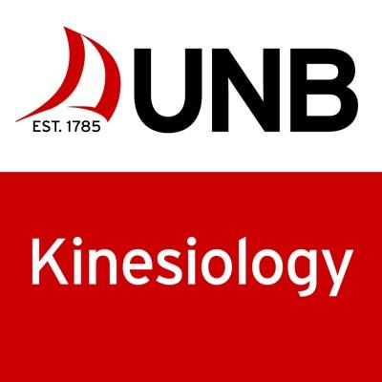
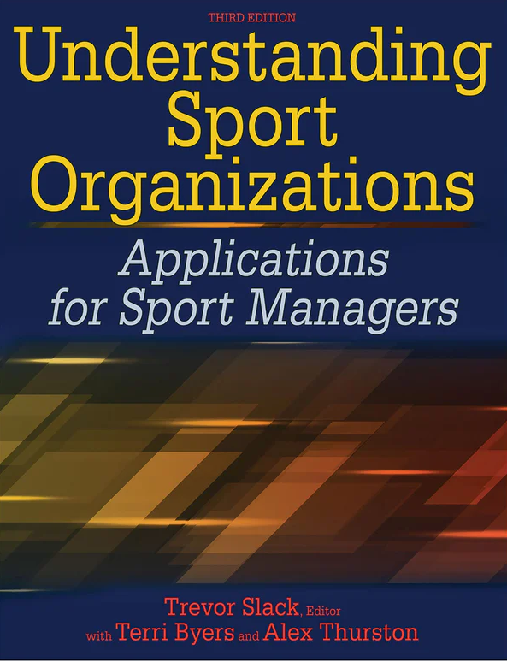


Terri Byers
…Professor, UNB, Faculty of Kinesiology
… England, 20 years, UNB 10 years
…MANAGING sport organizations
  Funding for sport, goals/effectiveness, the environment
  Managing change, conflict, technology, leadership
  Structures and cultures, policy & strategy
  Power & politics, CSR, mental health, analytics…
  AND…GOVERNANCE!
    HOW DO YOU FEEL ABOUT GOVERNANCE???

Slide 3
Club Governance
Your attitude Your board’s attitude
Questions?.........
Difficulties?......

Slide 4



Slide 5

Governance

Slide 6
What is governance?
BOTH – a great crew AND, at times, a perfect storm…
NEVER perfect! Always changing…
A GOOD THING!
…NO CHANGE [in GOVERNANCE] is VERY BAD ☹…

Slide 7

Governance
How decisions are made – happens at national, provincial and local levels/organizations…
Governance principles of ‘good governance’ to guide…
  Transparency, accountability, democracy
Different from ‘management’ (should be)
  Implementation of those ‘governance’ decisions, processes, policies….
  Managing goals, effectiveness, conflict, stakeholders, programs

Slide 8

So WHAT????
Better Governance = more transparent, responsible, democratic
  Better management of clubs
  More informed decision making – better decisions
  Confidence in club decisions
  Willingness of community to serve, be involved
  Increase membership
  Impacts of club activity on community, diverse groups

Slide 9
‘Levels’ of governance
Systemic
Stakeholder control of how sport organizations operate
Political
The way in which the state steers, regulates sport organizations
Organizational
Work of the board; regulatory and ethical standards of administrative behavior

Slide 10
‘Modes’ of Governance
Within the board…
  Fiduciary
    Stewardship of assets in line with mission
    ‘compliance mode’, financial responsibility to paying members; legal
    Act in benefit to organization, not personal
  Strategic
    Strategic mode / planning; image
  Generative
    Analyze complex problems, reflect on issues facing the club/organization, opportunities, challenges….

Slide 11
Better Governance in YC? 10 TIPS….
1. Knowing where you are – take stock of your governance…
-honest assessment??
2. Identify where you can / should improve & why…
3. Make a plan, timescales (this year, next, long term…)
Budget?
4. Building capacity (identify ‘a’ champion)…
5. Communicate/collaborate with other clubs

Slide 12
Cont…
6. Don’t be afraid to discuss change!
7. Examine board composition… improve diversity?
8. Create turnover in board, new blood…
9. Fully utilize ad hoc committees to inform the board’s decisions.
10. Take some risks, try to improve governance or your understanding of it…

Slide 13
TOP TIP - Taking Stock….
What does GOOD governance look like? BETTER governance?
Organizational governance of clubs
  Clear mission and vision of your club?
  Formal bylaws/rules that we follow?
  Culture of the board/club? – respect diversity of voices
  Composition of the board?
    Diversity? Skills?
  What modes do we operate?
    Fiduciary, generative, strategic

Slide 14
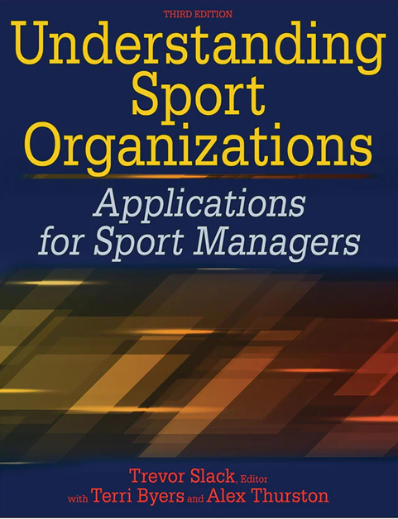
NOT simple…
Sport organizations / small clubs
  Complex ‘organisms’
  People VERY important – new people, new ideas
  What is our problem???? (s)
    No rules, too many rules
    Culture?
    Conflict
    Stagnation
    Lack of leadership
    Stuck in the past
    Lack of growth, no youth membership

Slide 15

Further Questions…
THANK YOU……
  tbyers@unb.ca

